Slide 1

- Releasing God’s life

Slide 2
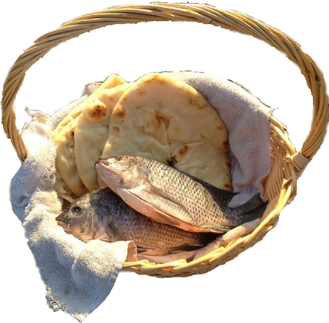
The living God
and the Transformation Theology in NCD

Slide 3
Transformation Theology
- Defined
A theological approach rooted in the conviction that the Kingdom of God is breaking into the world, bringing renewal and transformation wherever God's life-giving presence is received and expressed.
Believers are invited to participate as co-workers (synergoi) with God in His ongoing work of restoration and renewal.

Slide 4

The living God
and the Transformation Theology in NCD
«So then let us cast off the works of darkness and put on the armor of light.»
Rom. 13,12 (last part)

Slide 5
Synergy
- The Cooperation between God and People
«Synergy, the cooperation of God and men, is neither a symmetrical relation nor one in which the divine overpowers and replaces the human. It is rather one in which the human becomes fully human by embracing the divine.»
David Bradshaw, orthodox philosopher
(The Concept of the Divine Energies)
Notes:
God’s Energy - Refocusing Our Image of God, Volume II of the Energy Trilogy, Christian A. Schwarz, page 125

Slide 6
God in Us
- Biblical Imagery of Symbiosis
The body of Christ
God's presence embodied in
our heads, hearts, and hands
Now you are the body of Christ and individually members of it.
1 Cor 12:27

Slide 7
God in Us
- Biblical Imagery of Symbiosis
The body of Christ
God's presence embodied in
our heads, hearts, and hands
Breath
God’s breath (pneuma) giving life
And when he had said this, he breathed on them and said to them, “Receive the Holy Spirit. If you forgive the sins of any, they are forgiven them; if you withhold forgiveness from any, it is withheld.”
John. 20:22-23

Slide 8



Slide 9
God in Us
- Biblical Expressions of Participation
The body of Christ
God's presence embodied in
our heads, hearts, and hands
Breath
God’s breath (pneuma) giving life
Water
God’s living water flowing from the spring
Let anyone who is thirsty come to me and drink. Whoever believes in me, as Scripture has said, rivers of living water will flow from within them.
John 7:37-38
Notes:
Other expressions:
The Vine, branches and fruit, The Aroma of God, Jars of Clay, Co-workers …
English Standard:
Now unto him that is able to do exceeding abundantly above all that we ask or think, according to the power that works (ἐνεργουμένην | energouménen | energized) within us.

Slide 10
God in Us
- Biblical Expressions of Participation
The body of Christ
God's presence embodied in
our heads, hearts, and hands
Breath
God’s breath (pneuma) giving life
Water
God’s living water flowing from the spring
Light
God’s light shining in our hearts
For God, who said, “Let light shine out of darkness,” has shone in our hearts to give the light of the knowledge of the glory of God in the face of Jesus Christ.
2 Cor. 4:6
Notes:
Other expressions:
The Vine, branches and fruit, The Aroma of God, Jars of Clay, Co-workers …
English Standard:
Now unto him that is able to do exceeding abundantly above all that we ask or think, according to the power that works (ἐνεργουμένην | energouménen | energized) within us.

Slide 11




God in Us
- Biblical Expressions of Participation
For God, who said, “Let light shine out of darkness,” has shone in our hearts to give the light of the knowledge of the glory of God in the face of Jesus Christ.
2 Cor. 4:6
Notes:
Matt. 5:16 - In the same way, let your light shine before others, so that they may see your good works and give glory to your Father who is in heaven.

Slide 12
God in Us
- Biblical Expressions of Participation
The body of Christ
God's presence embodied in
our heads, hearts, and hands
Breath
God’s breath (pneuma) giving life
Water
God’s living water flowing from the spring
Light
God’s light shining in our hearts
Energy
God’s life energizing us
Now to him who is able to do far more abundantly than all that we ask or think, according to the power that is energized in us,
Eph. 3:20
Notes:
Other expressions:
The Vine, branches and fruit, The Aroma of God, Jars of Clay, Co-workers …
English Standard:
Now unto him that is able to do exceeding abundantly above all that we ask or think, according to the power that works (ἐνεργουμένην | energouménen | energized) within us.

Slide 13

Synergy
- The Cooperation between God and People
The biblical concept of synergy
The energy paradigm is key to understanding the relationship between God’s work and human activity.
Christian A. Schwarz (God’s Energy, volume 1)
Notes:
Nr. 3 av de 12 fellestrekkene Christian oppsummerer de 30 bibelversene med.

Slide 14
Energy, a key concept in the NT
- But still largely undiscovered
Noun:
Energy, enérgeia (ἐνέργεια) or enérgema (ἐνέργημα)
Adjective:
Energy-filled, energés (ἐνεργής)
Verb:
To energize, energéo (ἐνεργέω)
10x
3x
21x
Notes:
energon
energémata
energomen

Slide 15
Energy, a key concept in the NT
- But still largely undiscovered
Transcendent level
(invisible/metaphysical)
God
1
2
3
A
4
B
cause
effect
Notes:
Schwarz, Christian A.. God's Energy: Reclaiming A New Testament Reality (The Energy Trilogy Book 1) (p. 69). NCD Media.
Line 1 symbolizes the arrow energizing the empirically visible cause. Line 2 symbolizes the arrow energizing the principles applied. Line 3 symbolizes the arrow energizing the effects. Line 4 symbolizes the only reality that is empirically accessible, the arrow that connects the cause (left) with the effect (right). Finally, line 5 represents God, the source of all energizing. The advantage of this reduced sort of pictogram is that it can be scaled down at will, taking only the space of a single letter ( ), while still displaying the necessary elements in all imaginable clarity.

Slide 16
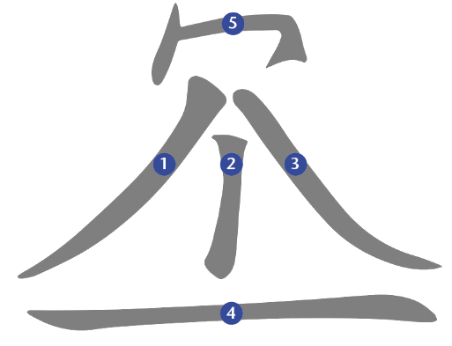
Energy, a key concept in the NT
- But still largely undiscovered
Notes:
Schwarz, Christian A.. God's Energy: Reclaiming A New Testament Reality (The Energy Trilogy Book 1) (p. 71). NCD Media.
Line 1 symbolizes the arrow energizing the empirically visible cause. Line 2 symbolizes the arrow energizing the principles applied. Line 3 symbolizes the arrow energizing the effects. Line 4 symbolizes the only reality that is empirically accessible, the arrow that connects the cause (left) with the effect (right). Finally, line 5 represents God, the source of all energizing. The advantage of this reduced sort of pictogram is that it can be scaled down at will, taking only the space of a single letter ( ), while still displaying the necessary elements in all imaginable clarity.

Slide 17

Synergy
- Colossians 1:29
For which I also labor, striving according to his energy (ἐνέργειαν | enérgeian | KJV: working) which is being energized (KJV: works) in me mightily.
Notes:
Schwarz, Christian A.. God's Energy: Reclaiming A New Testament Reality (The Energy Trilogy Book 1) (p. 92). NCD Media. Kindle Edition.

Slide 18
Synergy
- Philippians 2:13
For it is God who is the energizer (ἐνεργῶν | energón | KJV: who works) in you both to will and to energize (ἐνεργεῖν | energeín | KJV: to do) in order to fulfill his good pleasure.
Notes:
Schwarz, Christian A.. God's Energy: Reclaiming A New Testament Reality (The Energy Trilogy Book 1) (pp. 126-127). NCD Media. Kindle Edition.

Slide 19
Synergy
- Ephesians 4:16
From whom the whole body being fitly joined together and knit together by that which every joint supplies, according to the energy (ἐνέργειαν | enérgeian | KJV: effectual working) in the measure of every part, makes increase of the body unto the building up (KJV: edifying) of itself in love.
Notes:
Schwarz, Christian A.. God's Energy: Reclaiming A New Testament Reality (The Energy Trilogy Book 1) (p. 88). NCD Media. Kindle Edition.

Slide 20
The living God
and the Transformation Theology in NCD

Slide 21

The Transformational Theology
- In NCD
faith
ministry
Holistic
small groups
Empowering
leadership
Effective
structures
Passionate
spirituality
Need-oriented
evangelism
Loving
relationship
Inspiring
worship service
Gift-based
ministry
community

Slide 22
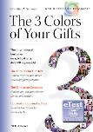
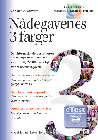
To Discover and Use Gods Gifts
- Gift-based ministry
There are different kinds of gifts, but the same Spirit distributes them | Spirit gifts | power
There are different kinds of service, but the same Lord. | Jesus service | commitment
There are different kinds of energies, but the same God. | Creator energies | wisdom
… but the same God who energizes all in all.
1 Cor. 12:4-6
Notes:
The 3 Colors of Your Gifts (Christian A. Schwarz) page 15
Now there are varieties of gifts, but the same Spirit;
and there are varieties of service, but the same Lord;
and there are varieties of activities,
but it is the same God who empowers them all in everyone. (1 Cor. 12:4-6, English Standard version)
There are different kinds of gifts, but the same Spirit distributes them.
There are different kinds of service, but the same Lord.
There are different kinds of working, but in all of them and in everyone it is the same God at work. (New International version)
And there are diversities of activities, but it is the same God who works all in all. (New King James version)
And there are different effects of energy (ἐνεργημάτων | energemáton | KJV: diversities of workings), but it is the same God who energizes (KJV: works) all in all.
Schwarz, Christian A.. God's Energy: Reclaiming A New Testament Reality (The Energy Trilogy Book 1) (p. 100). NCD Media. Kindle Edition.

Slide 23
The Symbiosis of Discipleship
- Gift-based ministry
>
>
energies
spiritual gifts
ministries
❶
❷
❸
God
The symbiosis
(God and me)
Others
Notes:
Through the energies (1), we gain access to God's power; the energies represent God's presence within us. We can express the energies most effectively through the channel that the spiritual gifts (2) provide. These gifts must be connected to appropriate ministries (3), and through these ministries, we bless the lives of others.
The 3 Colors of Your Gifts (Christian A. Schwarz) page 21

Slide 24
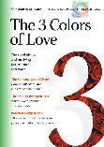
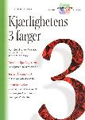


The Armor of Light
- The fruits of the Spirit and loving relationship
Truth
Grace
Justice
God is light
This is the message we have heard from him and proclaim to you, that God is light, and in him is no darkness at all.
1 John. 1:5
God is love
Anyone who does not love does not know God, because God is love.
1 John. 4:8
love

Slide 25
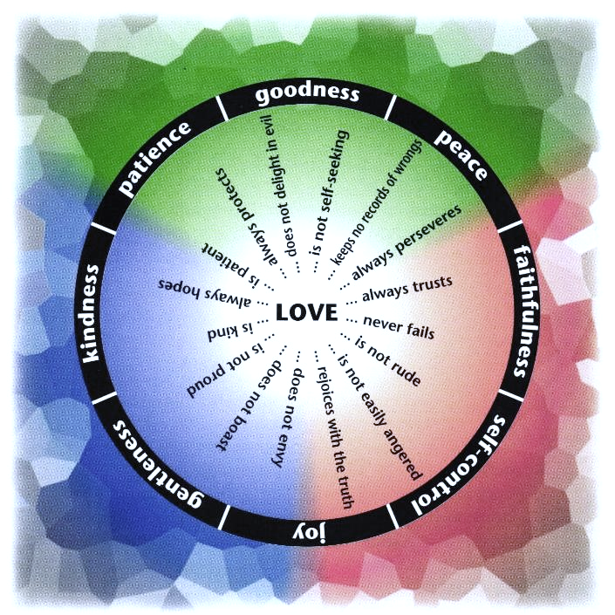
Notes:
Love is patient and kind; love does not envy or boast; it is not arrogant or rude.
It does not insist on its own way; it is not irritable or resentful; it does not rejoice at wrongdoing, but rejoices with the truth.
Love bears all things, believes all things, hopes all things, endures all things. (1 Cor. 13:4-7)

Slide 26
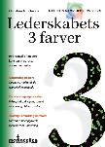
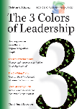

Leaders Who Release and Transform Energy
- Empowering leadership
Notes:
From The 3 Colors of Leadership by Christian A. Schwarz (NCD)
See also Multipliers by Liz Wiseman.

Slide 27


Leaders Who Give Freedom and Transform Energy
- Empowering leadership
“traditional approach”
Followers as helpers of the leader.
Modern approach
Empowering leadership resulting in ongoing leadership multiplication.
Notes:
From The 3 Colors of Leadership by Christian A. Schwarz (NCD)
See also Multipliers by Liz Wiseman.

Slide 28
Leaders Who Give New Life
- Empowering leadership
The church needs leaders who reflect
the life-giving side of God's nature.
Leaders who are not dependent on
draining the life out of those around them,
who do not exhaust the people around them,
who do not burn you out.
Instead, leaders who give life to people,
build them up, bring healing, and create new strength.
Hans Johan Sagrusten
:*) see also Philippians 2,13
Notes:
This quote has been translated from Norwegian by NCD Norway. This book has the Norwegian title Johannes’ openberring. It is a book about Revelation (the last book in the Holy Bible)
The Norwegian text (Nynorsk): Kyrkja treng leiarar som speglar den livgjevande sida av Guds vesen. Som ikkje er avhengig av å suge livet ut av alle omkring seg. Som ikkje brukar opp menneska rundt seg. Som ikkje brenner deg ut. Men som gjev liv til menneska, som byggjer deg opp, som gjev lækjedom og skapar nye krefter. ((Johannes’ openberring, page 264)
For it is God who is the energizer (ἐνεργῶν | energón | KJV: who works) in you both to will and to energize (ἐνεργεῖν | energeín | KJV: to do) in order to fulfill his good pleasure.

Slide 29
Leaders Who Release
- Empowering leadership
To what extent does leadership contribute to:
empowering new leaders at all levels?
strengthening people’s freedom, maturity, and sense of responsibility?
realising the visions and gifts that God has given each person and the congregation?

Slide 30
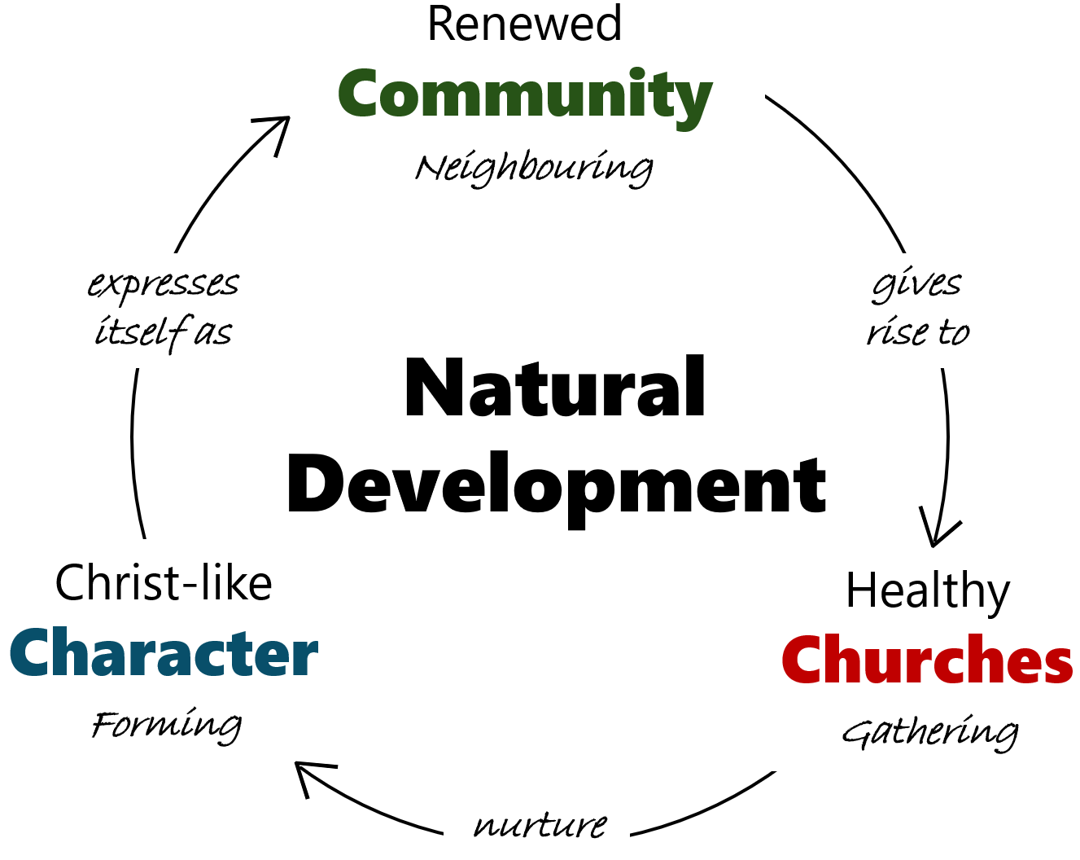
The Living Cykle of Transformation
- The Way of True Life

Slide 31
Transformed
- by The Holy Spirit
But when one turns to the Lord, the veil is removed. Now the Lord is the Spirit, and where the Spirit of the Lord is, there is freedom. And we all, with unveiled face, beholding the glory of the Lord, are being transformed into the same image from one degree of glory to another. For this comes from the Lord who is the Spirit.
2 Cor 3:16-18

Slide 32


- Life, when aligned with its source, grows.
ncd.life

Slide 33


