Slide 1
The Growth Cycle
Grow Healthier. Lead more wisely. Disciple more deeply.

Slide 2
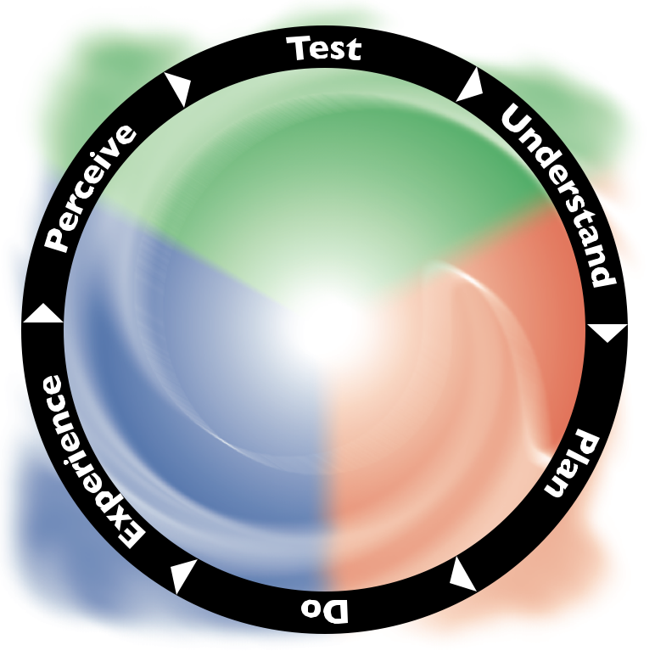

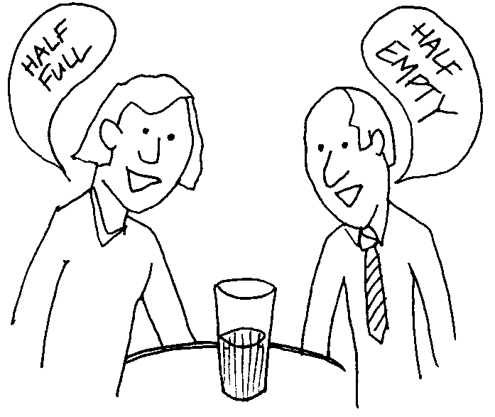


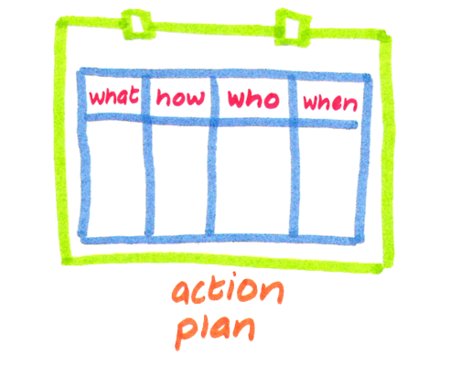
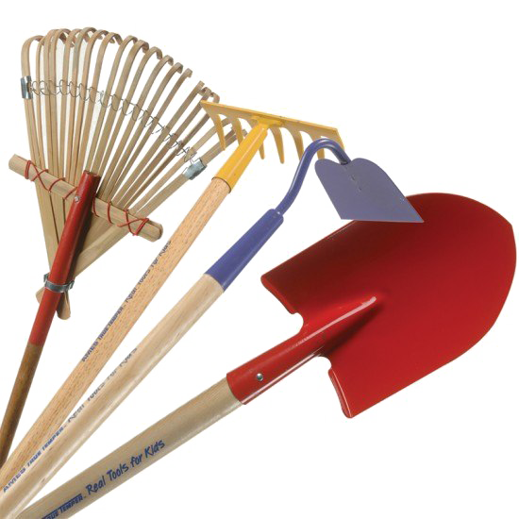
i
r
r
e
a
r
B
s
Notes:
See the cycle fitting on the Trinitarian Compass:
Green people will enjoy the activities in the greener phases (Perceive, Test, Understand) … often teachers, accountants, engineers ☺
Red people will enjoy the doing, later understand, plan and early do
Blue people will enjoy the experience and perceive phases, typically don’t like structure and processes very much
I have done a whole series on what can happen in each of these phases, what to watch out for, but that may be better for the practitioners circle

Slide 3

A Living Cycle
Remember:
  We are gardeners not mechanics
The cycle is:
  Continuous
  Natural
When applied wisely:
  Growth is guided, not constrained
  Barriers to growth are recognised and removed
  Doing is balanced with understanding, experiencing and perceiving

Slide 4





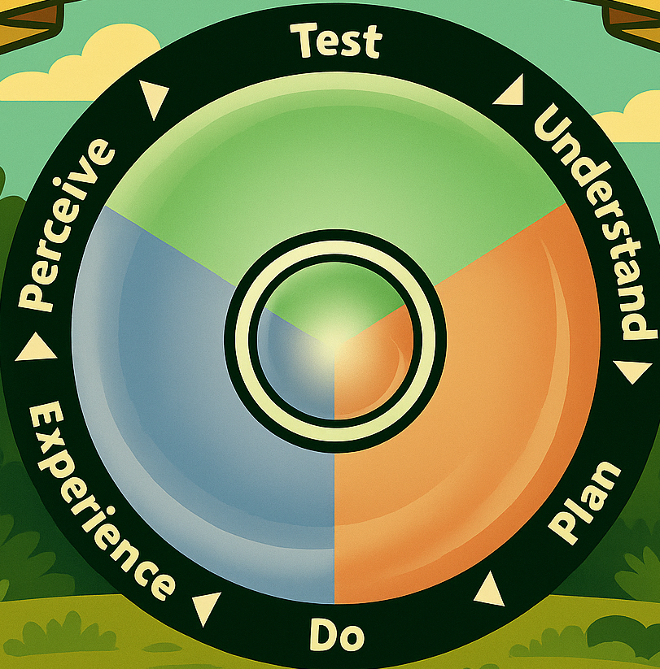



Test
Plan
Let’s dig deeper — what’s the barrier to more fruitfulness?
“What do we need to get there? Who’s driving? What should be bring? What do we need to leave behind?”
“Where are we headed? What is the world beyond the barrier like?”
“Are we clearly seeing what’s happening?”
Understand
Perceive
Experience
“Look at what God has done — more fruitful life!”
Do
“Is it like we expected?
Where next?
“Let’s clear the barriers and get moving!”

Slide 5
Coaching the Growth Cycle
Process guide
Navigator in the NCD process
Interpreter and guide
Shaping leaders
Mentor and church health practitioner
Formational coach
Cultural and system-level change
Spiritual companion and systems thinker
Developmental coach
Deeper insights and integration of tools
Complex situations
Coaching is about the right conversations:
Good questions
Grounded in observations from the data
Ownership
Transformation

Slide 6
Coaching in an A.I. world
From analysis to facilitating conversations
A.I. accelerates preparation;
  Recognises patterns
  Summarises
  Drafts questions
Coach brings:
  Discernment
  Wisdom
  Experience
Quickly getting to the needed conversation in a highly focused way

Slide 7
Applying the Growth Cycle 1-to-1 and in Small Groups
Vision questions
Experimentation questions
Capacity questions
Strategy questions
Training questions
Progression questions
Experimen-tation questions
Capacity questions
Strategy questions
Training questions
Progres-sion questions
Vision questions
Spiritual Change

Slide 8
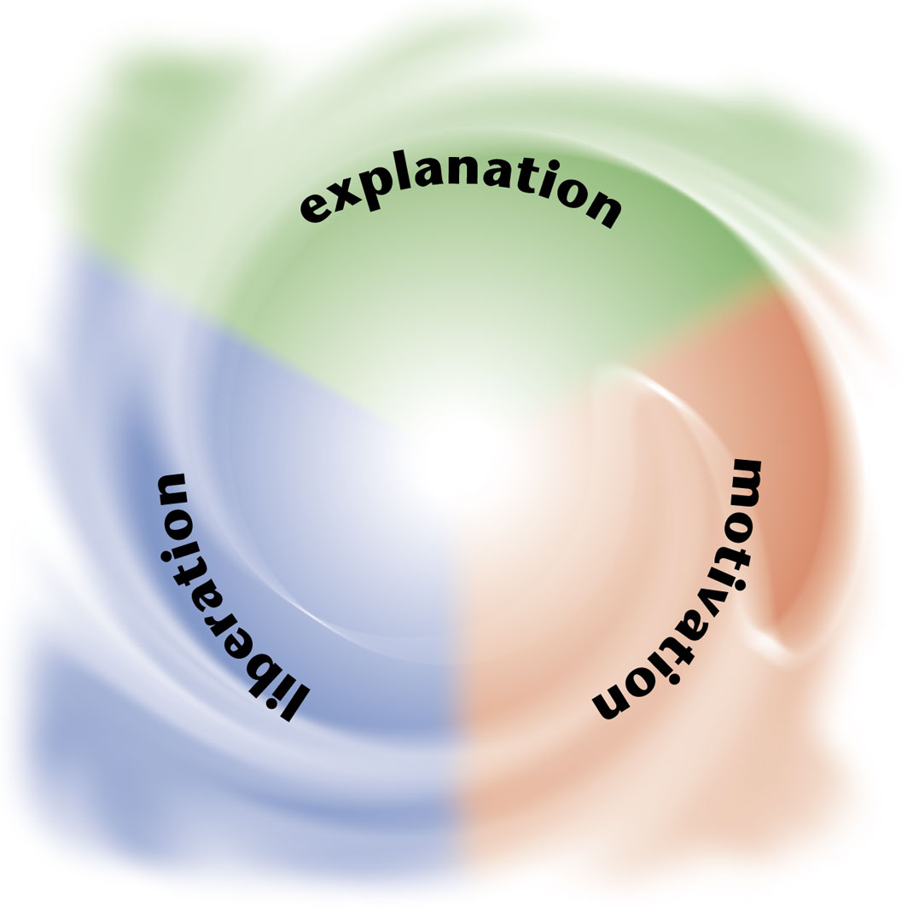



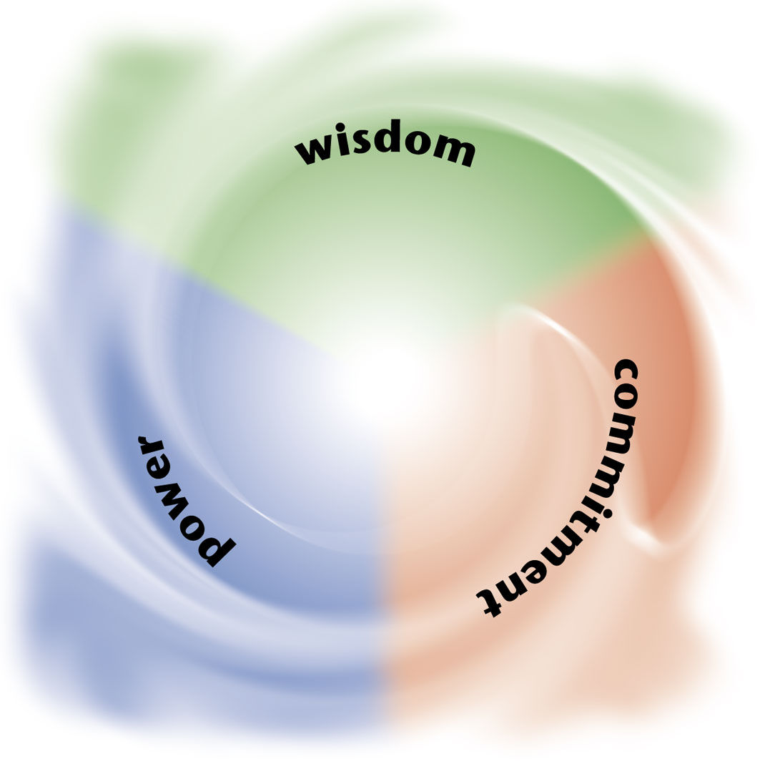



Trinitarian Balance for each Discipleship Area
Empowering
Passionate
Inspiring
Need-Oriented
Leadership
Spirituality
Worship Services
Evangelism
Gift-based
Effective
Holistic
Loving
Ministry
Structures
Small Groups
Relationships
Notes:
Introduce the eight QCs:
Every church has the nouns
But healthy churches, that is, those which are growing, have the adjectives
Each of these can be deep-dived through a Trinitarian Compass lense, as we see here
For example, an empowering leader balances explaining, motivating, and liberating
A Holistic small group cares for the heads, hands and hearts of peole

Slide 9
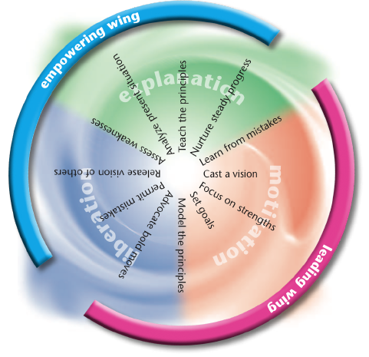
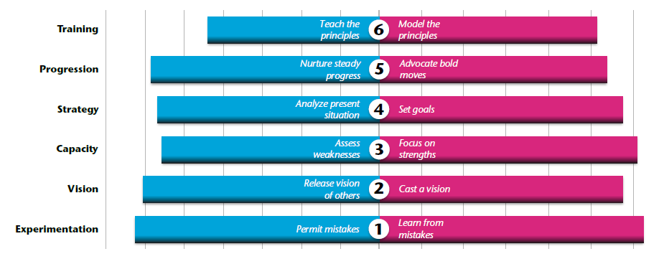
Trinitarian Balance for each Discipleship Area
Empowering
Leadership
Notes:
Introduce the eight QCs:
Every church has the nouns
But healthy churches, that is, those which are growing, have the adjectives
Each of these can be deep-dived through a Trinitarian Compass lense, as we see here
For example, an empowering leader balances explaining, motivating, and liberating
A Holistic small group cares for the heads, hands and hearts of peole

Slide 10
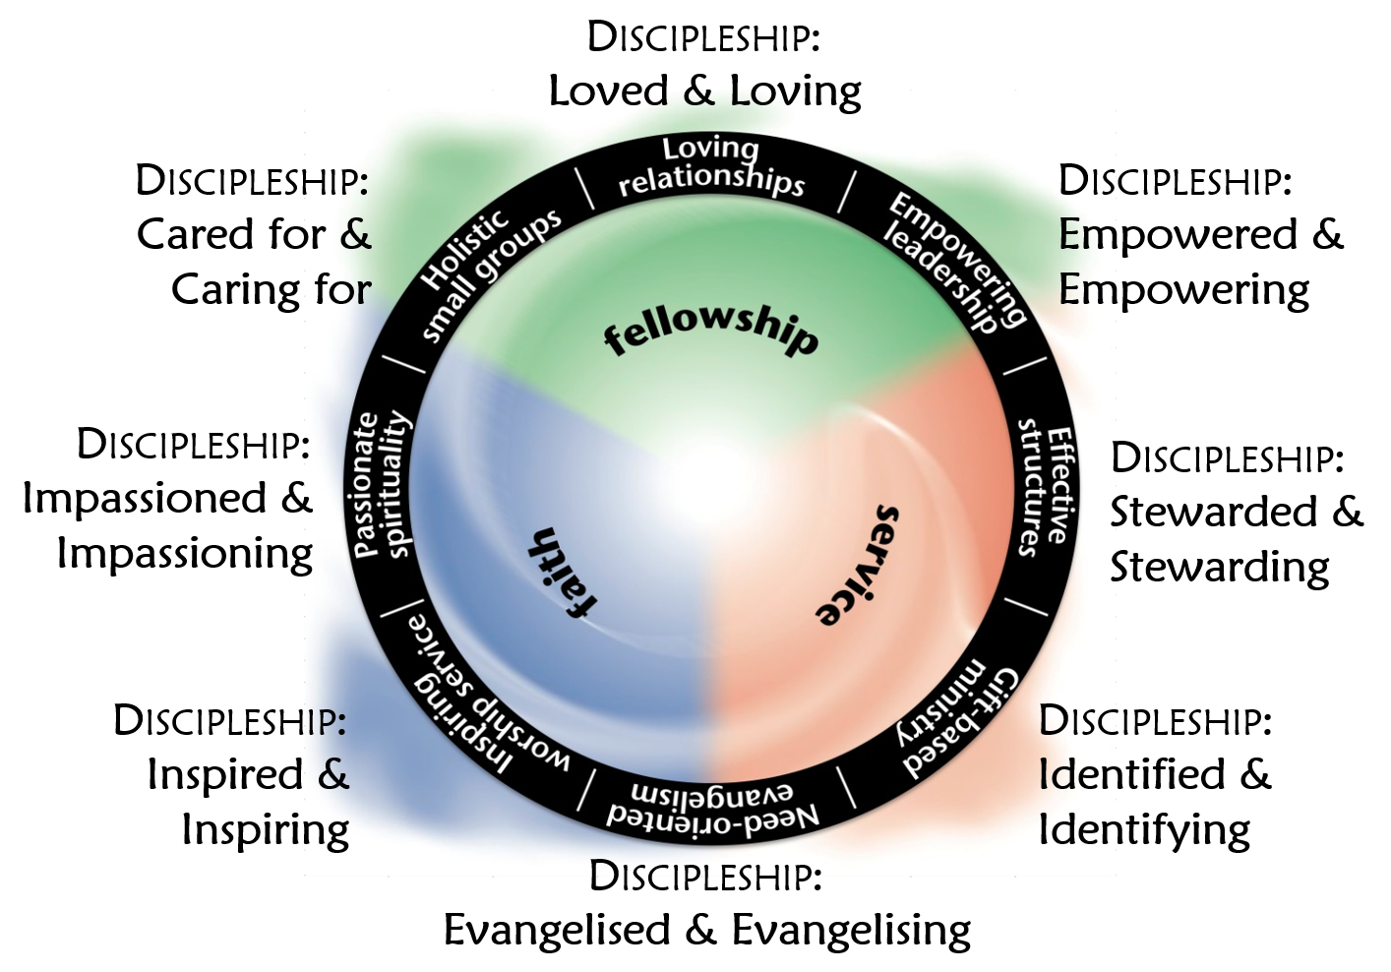

Christ-like Character

Slide 11


