Slide 1
Building
on
The Rock

Slide 2
NCD Before Adam

Slide 3
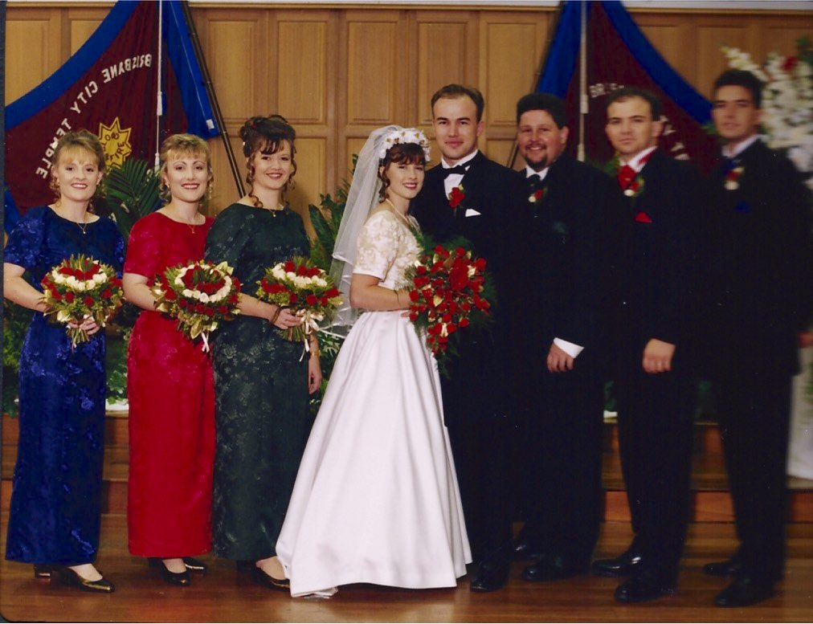

Slide 4
NCD Before
the ’94-’96
International Research

Slide 5
NCD Before
The Schwarz’

Slide 6
NCD Before
The Reformation

Slide 7
NCD Before
The Councils of
Nicaea and Constantinople

Slide 8
NCD B.C.

Slide 9

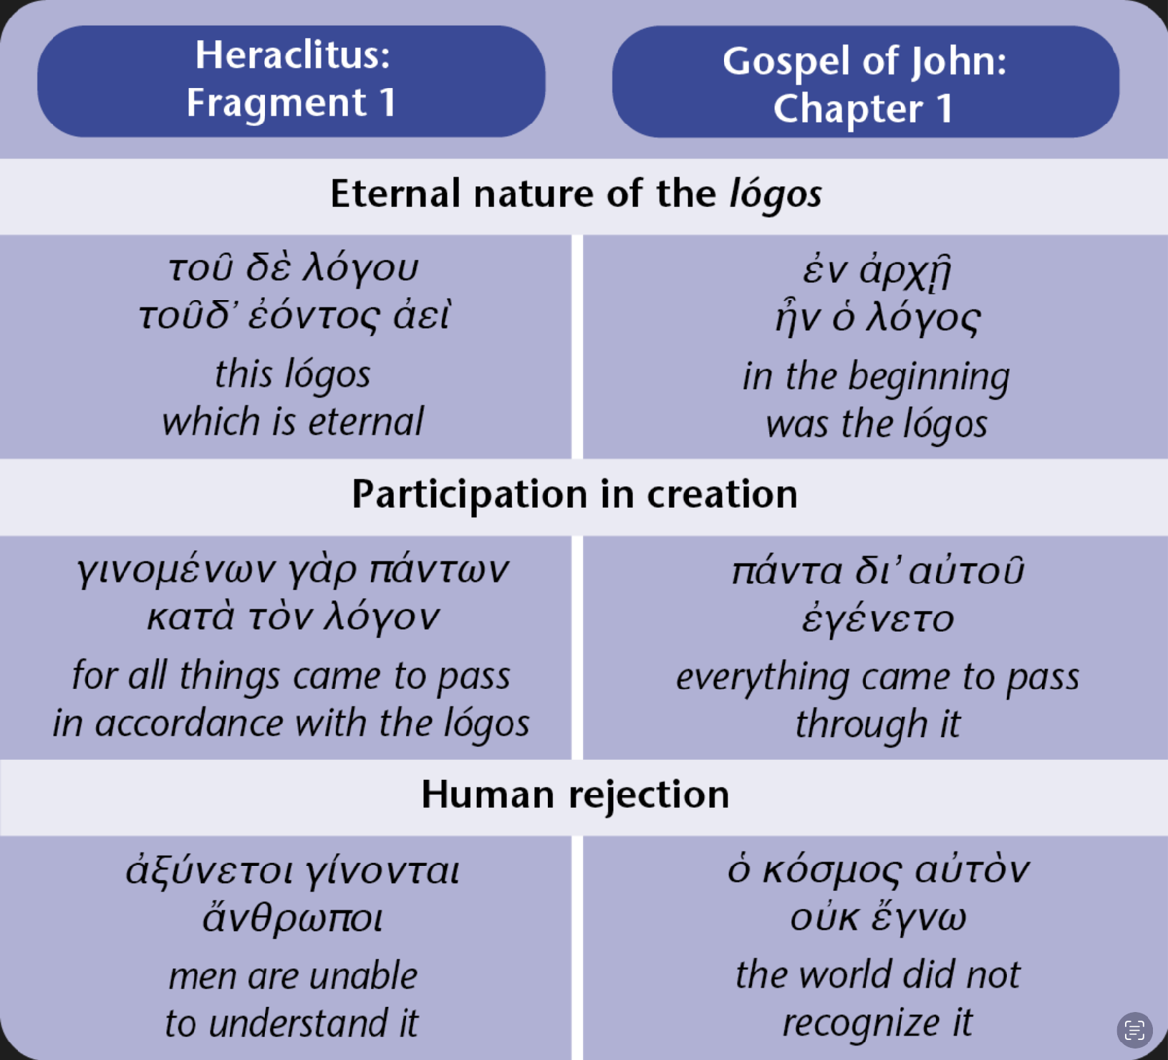
In the beginning was the logos…
Word
Fiery Reason
The Way of True Life

Slide 10
John 1: The revealing of a mystery
In the beginning was the Way of True Life.
The Way of True Life was with God,
and the Way of True Life was God.
Through the Way of True Life all things came into being.
Apart from the Way of True Life,
nothing came into being that has come into being.
The Way of True Life was in the world,
and though the world came into being through the Way of True Life,
the world did not recognise it.
The Way of True Life came to its own,
but its own did not receive it.

Slide 11
John 1: The revealing of a mystery
And the Way of True Life became flesh
and lived among us.
We have seen His glory—
the glory of the Father’s one and only Son,
full of grace and truth.

Slide 12
John 1
transpersonal logos
John 14
personal logos
The Way…
I am
the Way,
the Truth, and the Life
…Life
…of True…

Slide 13
Attentive to the Kingdom and the King
Worshipping a
Kingdom
without a King
Kingdom
with a
King
Worshipping a
King
without a Kingdom
Creation
Creation
3-fold revelation
Spirit
Bible
Spirit
Bible
“There is a way of true life!”
“Jesus is the Way,
the Truth, and the Life!

Slide 14

Building on the rock
The Kingdom Way of True Life

Slide 15
A house
that reflects the King
Whether it be our…
own life
family
team or small group
local church
denomination
town or whole nation
The Kingdom Way of True Life

Slide 16
A house
that reflects the King
NCD principles
are not just good ideas.
They are foundation stones of Kingdom reality
The Kingdom Way of True Life

Slide 17
A house
that reflects the King
Thoughts or questions?
The Kingdom Way of True Life

Slide 18
Disciple Reality Check

Slide 19
We have a global discipleship crisis!
On average around the world:
Higher formal theological education of pastors
correlates with lower levels of health in the churches they lead
Pastors go backwards in their capacity
to grow a healthy church after their late 30s
Church members go backwards spiritually over time
Churches struggle to make further progress in health once they
have improved their structures and need to grow their people

Slide 20
Go make disciples…
Baptising them into the reality of the Father, Son and Holy Spirit
And teaching them to live accordingly

Slide 21
…I never knew you
You can do almost
every imaginable activity of church life
without actually being
a disciple of Jesus!

Slide 22
Doctrine <——> Discipleship
Giving the same truth to everyone
Giving the right truth to the right person at the right time
The simplicity of the Gospel for this person right now
The complexity of theology
Knowing what is true
Becoming what is true
Focus on content
Focus on transformation
Truth-centred
Person-centred
The maximum or minimum factor for strengthening or stretching
All eight quality characteristics

Slide 23
The journey to life in all its fullness
evangelism
declaration
discipleship
The evangel is much larger than “Jesus died for your sins”
(as good as that news is!)
The full good news is that
Jesus is King
and His Kingdom is available
Discipleship of Jesus’
first followers began
before their declaration
of Him as Lord

Slide 24
Evangelised discipleship
evangelism
diagnosis
releases
grace
The journey to
reveals
truth
life in all its fullness
remediation
discipleship

Slide 25

Share my yoke
Come to me, all you who are weary and burdened, and I will give you rest.
Take my yoke upon you and learn from me,
for I am gentle and humble in heart,
and you will find rest for your souls.
For my yoke is easy and my burden is light.
The fixed leg of discipleship
Being reminded of
Jesus’ delight
Focusing on your
maximum factors
What is good or
getting better
The free leg of discipleship
Becoming all Jesus knows you can become
Focusing on your
minimum factors
What you need to be transformed
Attending to the fixed
and free leg of another
Doing for others what Jesus has done for you
Focusing on the maximum or minimum factors of others as needed
What they need right now

Slide 26
Are you addressing what Jesus
most wants to transform in your life?
There is of course more to being a disciple of Jesus than these three questions
— but there is not less.
Keep asking the questions:
In your private devotions
Around the dinner table
Before and after worship
In team meetings
In small groups
In conversations with
non-Christians
becoming
Are you
kidding
yourself?
Disciple Reality Check
being
doing
Do you know what Jesus delights in
when He looks at you?
Are you helping
someone else to answer
the other two questions?

Slide 27
NCD Discipleship Tools
NCD Church Survey
Empowering Leadership
Gift-based Ministry
Passionate Spirituality
Effective Structures
Inspiring Worship Service
Holistic Small Groups
Need-oriented Evangelism
Loving Relationships
Discipleship
Empowerment Test
Gift Test
Spiritual Style Test
Stewardship Test
Inspiration Test
Communal Test
Wholeness Test
Love Test
Every test helps an individual or group to:
Make progress in a specific quality characteristic
Start (or restart) the process of evangelised discipleship
Pay attention to their fixed leg and free leg
Answer the three Discipleship Reality Check questions

Slide 28
The Wholeness Test
How fulfilling is your life?
Our Need-oriented Evangelism discipleship tool
Can be used before and after declaring Jesus as Lord
Our shortest test (36 questions)
Reveals where you are tasting life in all its fullness
…and which cloud is keeping you in the dark
Provides three daily disciplines for growth
Is like an NCD Church Survey for everyday life
Maps seamlessly to the church survey categories
Serves as a road map into the other discipleship tests
Opens a natural door to meeting Jesus
It’s free!
embracing relationships
(fellowship)
Wholeness
unshakable confidence
purposeful contribution
(faith)
(service)

Slide 29
We can solve the discipleship crisis!
We can be obedient to the whole great commission
We can live out the process of evangelised discipleship
We can submit ourselves to the Disciple Reality Check
We can walk in the easy yoke with Jesus and others
We can take a free test to clarify our next steps
We can do this eye to eye with Christians and non-Christians
We can start right now!

Slide 30
Thoughts or questions?

Slide 31
Our Disciple Reality Check

Slide 32
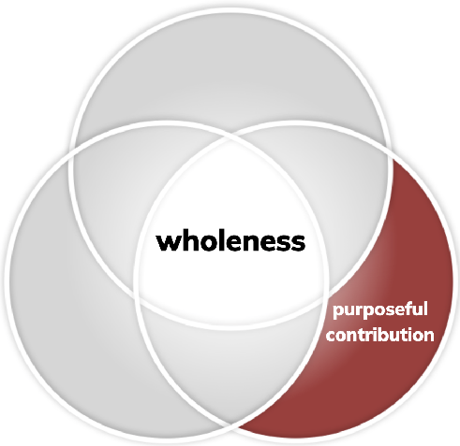
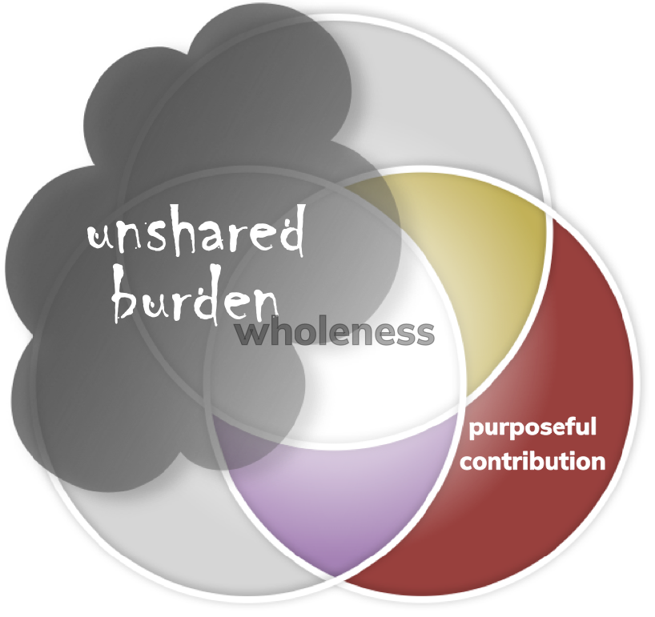
Please help me work out my salvation
embracing relationships
wholeness
unshakable confidence
purposeful contribution
Adam
Adam, your purposeful contribution adds to the wholeness around you as you…
The cloud of unshared burden will begin to lift from your life as you…
• Go without things for the sake of others.
• Volunteer for or give to causes you care about.
• Delegate what you cannot do or don’t have time for.
• Encourage and celebrate others.
• Connect with people or places that inspire you.
• Express gratitude for what is good or improving.

Slide 33
Let us be known, genuine, disciples
embracing relationships
1. Sit in your wholeness strength group
(see page 3 of your Wholeness Test results)
2. Make smaller groups of 3 people
(Preferably people you don’t know as well)
3. Introduce yourselves
Even if strangers, know that each of you need to experience evangelised discipleship
in dialogue
dia-logos: seeing the logos in each other
wholeness
unshakable confidence
purposeful contribution
Disciple Reality Check
Are you helping someone else to answer the other two questions?
(by having this conversation, you will be able to answer “yes” to this)
Do you know what Jesus delights in when He looks at you? (fixed leg)
(the left side of page 8 in your results may give some clues)
Are you addressing what Jesus most wants to transform in your life? (free leg)
(the right side of page 8 in your results may give some clues)

Slide 34
What did you discover together?

Slide 35
Supporting the NCD Journey

Slide 36
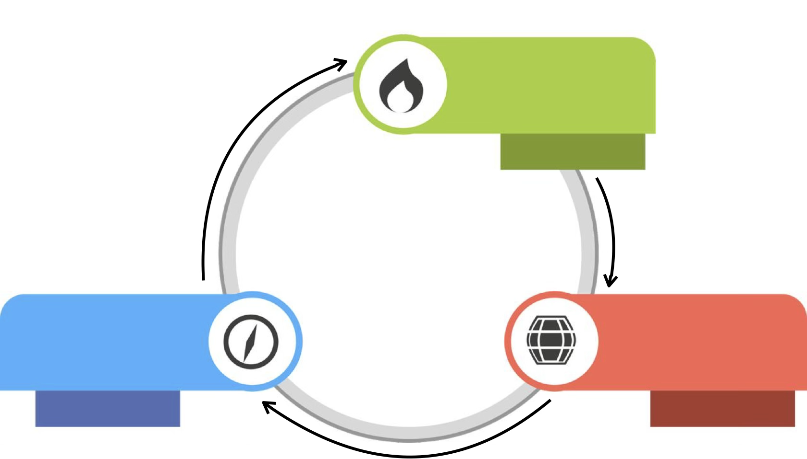
Renewed
Community
through
salt and light
expresses itself as
Neighbouring
Natural Development
gives rise to
Christ-like
Healthy
Character
Church
Forming
Gathering
nurtures
Building on The Rock — The Kingdom Way of True Life

Slide 37
Supporting the NCD World
National
Teams
National & Interdenominational
Mission Leader
and Campfire Host
Team of 8+ quality characteristic specialists
National Campfire Community
Denominational Teams
Quality Characteristic Teams

Slide 38

NCD Campfires
One hour Monthly gatherings
where you no longer have to feel alone, lost, or afraid

Slide 39
Supporting the NCD Team
National
Teams
National & Interdenominational
Mission Leader
and Campfire Host
Team of 8+ quality characteristic specialists
National Campfire Community
Denominational Teams
Quality Characteristic Teams
Denominational & International
Mission Leader
and Campfire Host
Team Members
Denominational Campfire Community
Celebrating and Solving the culture of their denomination and Seeking out those who could contribute to that mission
International & Interdenominational
Mission Leader
and Campfire Host
Team Members
Walking alongside others wrestling with a specific quality characteristic in their character, church or community
Resourcing local churches and denominations and addressing the culture of their nation through the principles of NCD

Slide 40
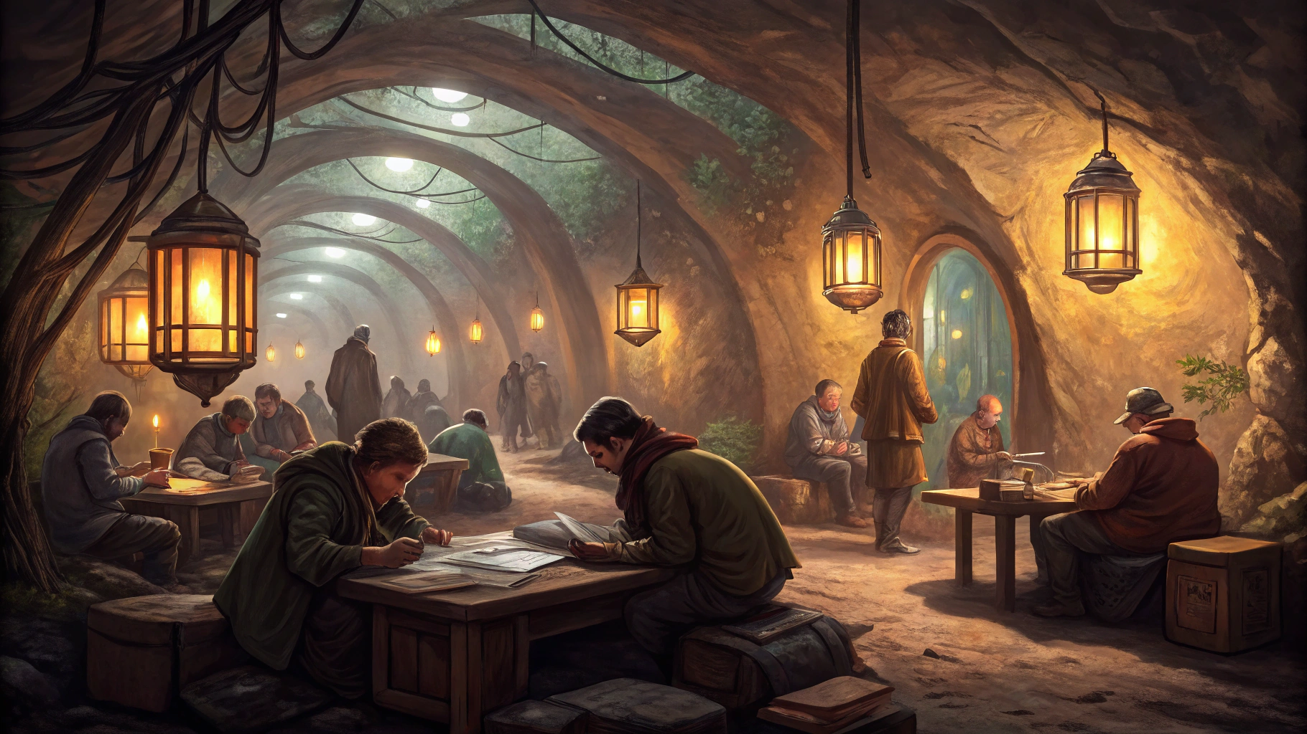
NCD Underground
A meeting place for National, Denominational and Quality Characteristic Team Members to collaborate

Slide 41
NCD is a process!

Slide 42
A typical NCD “process”
Survey results revealed
and action plan worked on
Follow up meeting
Initiate survey
The urgent overtakes the important
Someone remembers we did the NC… something survey
Decide to survey
We remember Jesus came to bring life…
Summer holidays
Jan Feb Mar Apr May Jun Jul Aug Sep Oct Nov Dec

Slide 43
Weekly and Daily Rhythms
The waking hours in a week and typical time in church activities.
How can we walk more consistently with our people, helping them stay on the journey to life?

Slide 44
NCD in your pocket
The Journey to Life App

Slide 45
NCD Journey to Life App
Free Wholeness Test & other eTests by subscription
Daily custom devotionals
Personalised disciple-making prompts
Your Journey
Wholeness Gatherings
QR code Sharing and Friend Finder

Slide 46
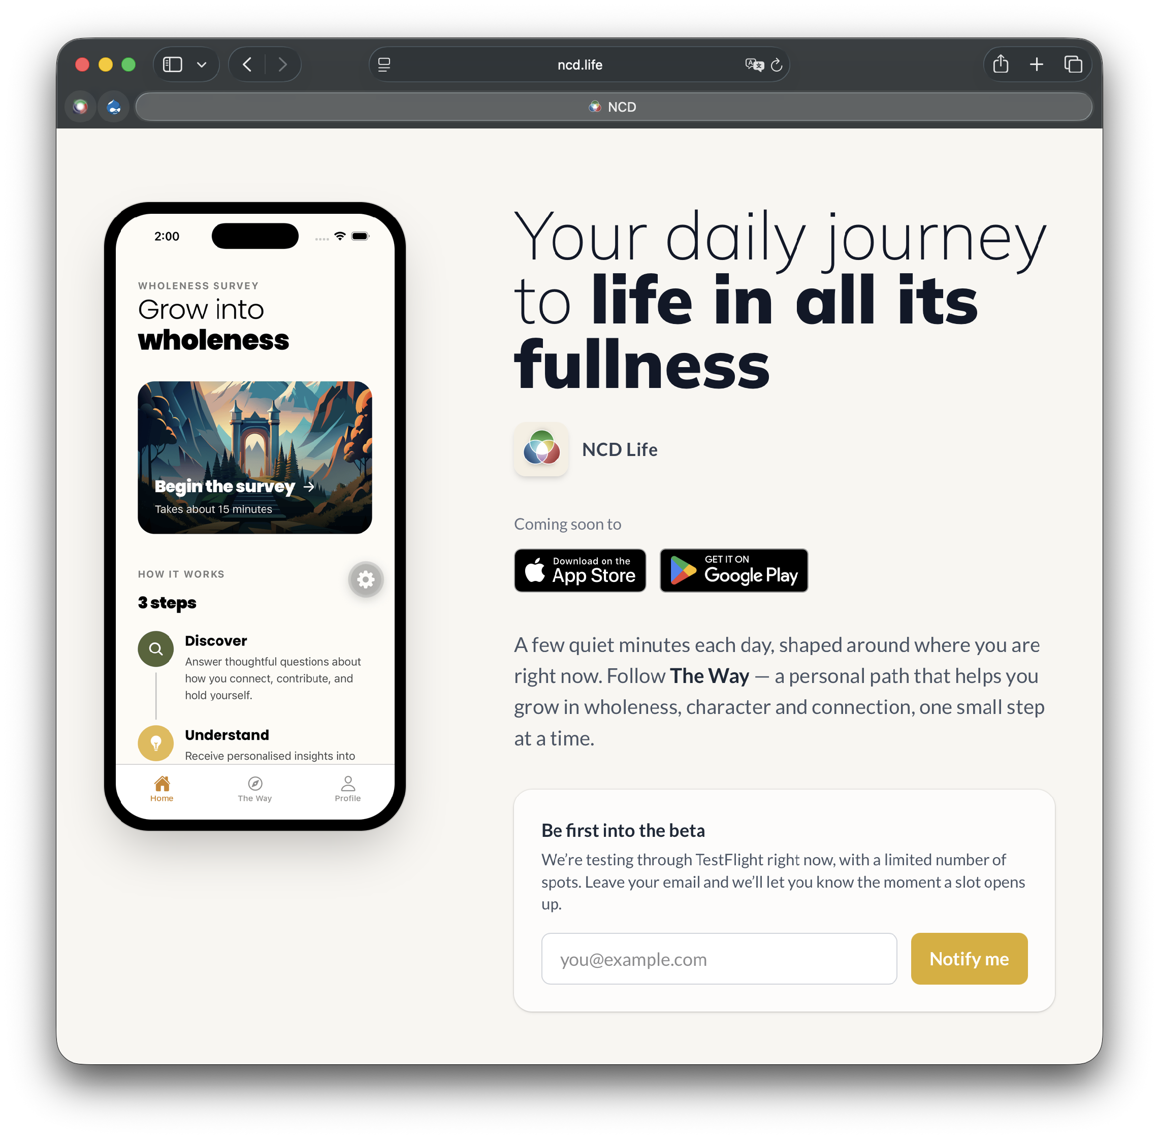
www.ncd.life/app

Slide 47
Thoughts or questions?

Slide 48
NCD Church Survey 7.0

Slide 49
The NCD Pot Plant
See
www.ncd.life/church
for the video

Slide 50
NCD Church Survey Development
1.0 Pre-empirical — The early work of Fritz and Christian
2.0 Empirical — ’94-’96 worldwide research and Basic Profile
3.0 Detailed Analysis — 2002 Profile Plus and other tools
4.0 Survey Review — 2007 retest and refinement of items
5.0 Online Survey — 2011 migration to online survey
6.0 NCD Perspectives — 2015 providing insights to participants
7.0 Data to Discernment — 2027 getting to the heart of results

Slide 51
How much life
are we allowing to flourish?
www.ncd.life/church

Slide 52



What is it revealing?
Where
to
next?
Why does this matter?
How can
we make progress?

Slide 53
Why does this matter?
Our Strength
We are grateful that this is a people who still care.
We see it in the way people pray for one another, in the instinct to move toward those in need, and in the desire to help people find life in Christ. We feel that our leaders genuinely care about people — not just programs or outcomes — and that matters deeply to us…
Our Struggle
At the same time, many of us quietly struggle to find places where we can be deeply known, trusted, and formed over time…
We often experience warmth, activity, and mission, yet still feel uncertain where we truly belong beyond the larger gathering or the immediate demands of ministry. Some of us long for friendships within the church that feel dependable enough to carry real life — not just shared tasks or polite conversations…
The voice of our people
The lived experience of our congregation
The impression on those we want to reach
The experience of those beyond our church
The Salvation Army Journey
The path people travel among us
What is it revealing?
Where
to
next?
Why does this matter?
How can
we make progress?

Slide 54
Why does this matter?
What draws us near
What we notice first is that you seem to care.
Many churches feel distant, self-protective, or preoccupied with themselves. But the Salvation Army often appears willing to move toward people in need rather than away from them. We see practical help, concern for struggling people, and a willingness to pray, listen, and respond…
What gives us pause
At the same time, some of us are unsure whether we could truly belong here over time.
Some of us who come needing support worry that we may receive help without ever really becoming part of a trusted community. We wonder where people talk honestly about life, where friendships become dependable, and where struggling people are patiently formed rather than simply assisted…
The voice of our people
The lived experience of our congregation
The impression on those we want to reach
The experience of those beyond our church
The Salvation Army Journey
The path people travel among us
What is it revealing?
Where
to
next?
Why does this matter?
How can
we make progress?

Slide 55
Why does this matter?
The voice of our people
The lived experience of our congregation
The impression on those we want to reach
The experience of those beyond our church
The Salvation Army Journey
The path people travel among us
What is it revealing?
Where
to
next?
Why does this matter?
How can
we make progress?

Slide 56
What is it revealing?
Maximum Factor: Need-oriented Evangelism
Highest Theme: We Move Toward Need with Prayerful Compassion
Minimum Factor: Holistic Small Groups
Lowest Theme: We Struggle to Form Reliable Communities of Shared Growth
The lens of reality
Themes emerging from our responses
The lens of Scripture
What we have, and have not yet, grasped
The lens of our aspirations
What is, compared to what we hope to be
What is it revealing?
Where
to
next?
Why does this matter?
How can
we make progress?

Slide 57
What is it revealing?
The global Salvation Army profile reveals a movement rich in compassion, prayer, and outward mission, yet carrying signs of strain in the deeper relational and formative structures needed to sustain that mission over time.
The Scriptures repeatedly refuse to separate those two realities.
The biblical vision is never:
mission without formation,
compassion without community,
or sacrifice without shared life.
The people of God are called not only to move toward the world in mercy, but also to become the kind of community capable of carrying mercy faithfully across generations.
What follows are several Scripture reflections that speak directly into the tensions emerging from the data…
The lens of reality
Themes emerging from our responses
The lens of Scripture
What we have, and have not yet, grasped
The lens of our aspirations
What is, compared to what we hope to be
What is it revealing?
Where
to
next?
Why does this matter?
How can
we make progress?

Slide 58
What is it revealing?
The lens of reality
Themes emerging from our responses
The lens of Scripture
What we have, and have not yet, grasped
The lens of our aspirations
What is, compared to what we hope to be
What is it revealing?
Where
to
next?
Why does this matter?
How can
we make progress?

Slide 59
How can we make progress?
1. What does Jesus delight in when He looks at you?
In what ways am I already helping carry the mission of Jesus through prayer, practical care, encouragement, generosity, or faithful service?
…
2. What is Jesus wanting to transform in your life right now?
Am I becoming deeply rooted in relationships where I am honestly known, supported, challenged, and prayed for — or am I mostly carrying my life alone?
…
3. Who is Jesus inviting you to walk alongside?
Who around me may need not only practical help, but deeper friendship, encouragement, prayer, and spiritual formation?
…
Attending to the vine
Practices to nurture life among us
Fixing our trellis
Structures to support life among us
Walking the journey
Rhythms to sustain life among us
What is it revealing?
Where
to
next?
Why does this matter?
How can
we make progress?

Slide 60
How can we make progress?
1. A Trellis Addition
Adding a shared Disciple Reality Check culture
The strongest addition suggested by the current profile is not another program, but a shared discipleship rhythm…
2. A Trellis Removal
Removing structures and expectations that unnecessarily centralise responsibility
Pastoral overload emerges as one of the clearest signals in the profile. This does not appear to arise primarily from lack of commitment, but from systems that unintentionally train people to rely heavily on officers and a small inner circle…
3. A Trellis Adjustment
Adjusting pathways from participation into formation and leadership…
Attending to the vine
Practices to nurture life among us
Fixing our trellis
Structures to support life among us
Walking the journey
Rhythms to sustain life among us
What is it revealing?
Where
to
next?
Why does this matter?
How can
we make progress?

Slide 61
How can we make progress?
Walking the Journey
Week 1. Carrying My Compassion Into the World
Week 2. When the Burden Becomes Too Heavy to Carry Alone
Week 3. So That My People May Not Walk Alone
Week 4. So the World May Find a Home Among You
Attending to the vine
Practices to nurture life among us
Fixing our trellis
Structures to support life among us
Walking the journey
Rhythms to sustain life among us
What is it revealing?
Where
to
next?
Why does this matter?
How can
we make progress?

Slide 62
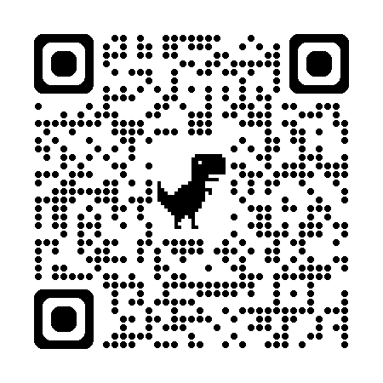
How can we make progress?
Attending to the vine
Practices to nurture life among us
Fixing our trellis
Structures to support life among us
Walking the journey
Rhythms to sustain life among us
What is it revealing?
Where
to
next?
Why does this matter?
How can
we make progress?

Slide 63
The Role of NCD Coaches
Lender of courage until they find their own
Celebrator of what is genuinely good or getting better
Protected outside observer and voice
Gentle disrupter and challenger of assumptions
Carrier of stories, wisdom, and experience
Accountability partner
Multiplier of other coaches
Bridge to the wider NCD Community & Toolbox

Slide 64
Thoughts or questions?

Slide 65
On earth as it is
in heaven

Slide 66
Lord, teach us to pray…
Our Father in the heavens
Your name be honoured
Your Kingdom come, your will be done, on earth as it is in heaven
Give us today what we need for today
Forgive us as we forgive others
Lead us away from temptation
Rescue us from evil

Slide 67
On Earth as it is in Heaven
Empowerment
Gift-activation
Passion
Effectiveness
Inspiration
Community
Wholeness
Love
Oppression
Stagnation
Apathy
Waste
Despair
Isolation
Fragmentation
Hate
Hell on Earth

Slide 68
Renewed
Community
Neighbouring
on earth as it is in heaven
Christ-like
Healthy
Character
Church
Forming
Gathering
Building on The Rock — The Kingdom Way of True Life

